Slide 1
The turnout for the Governorship Elections tanked by 9% from 1,269,106 recorded from the Presidential Election
Alimosho pooled the largest votes for the Presidential and Governorship Elections while Ibeju-Lekki recorded the least count of votes.
Apapa, Badagry, Epe, and Lagos Island churned out much more votes compared to the Presidential Elections

Slide 2
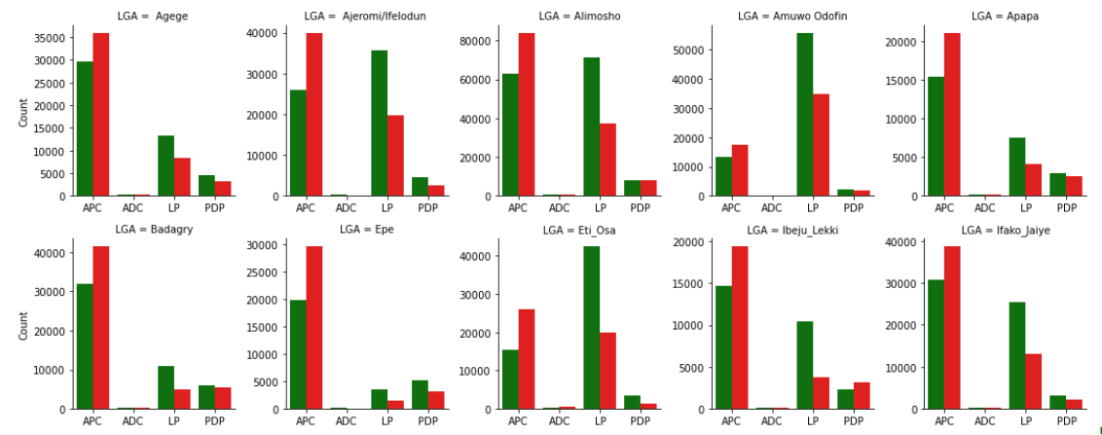

Breakdown of Results from the top 4 political Parties across the 20 Local Governments of Lagos State (1/2)
APC had at least 9% more votes in the Governorship Elections compared to the outcome of the Presidential Elections across all the local Governments.
APC had the highest number of votes in 18 Local governments and LP secured the most votes in 2 Local governments.

Slide 3
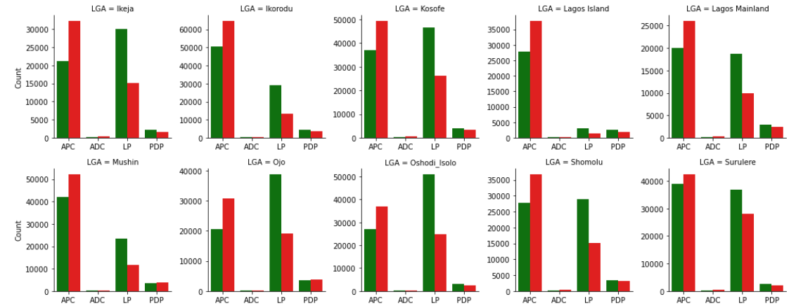
Breakdown of Results from the top 4 political Parties across the 20 Local Governments of Lagos State (2/2)

